Slide 1

Online Nurse Hiring System
SABNA KP
MES23MCA-2038
Department of Computer Applications
MES College of Engineering , Kuttippuram
04/10/2024

Slide 2
PRODUCT OWNER MR. BALACHANDRAN K.P ASSOCIATE PROFESSOR DEPARTMENT OF COMPUTER APPLICATIONS MES COLLEGE OF ENGINEERING, KUTTIPPURAM

Slide 3
TABLE OF CONTENTS
Introduction
Objective
Motivation
Functionalities
Module Description
Developing Environment
Sprint Backlog
Product Backlog
User Story
Project Plans
Data Flow Diagrams
ER Diagram

Slide 4
Online Nurse Hiring System
“Online Nurse Hiring System” is a web based application which contains data and information of nurses.
In Online Nurse Hiring System we use PHP and MySQL database. This is the project which keeps records of nurses.
The “Online Nurse Hiring System” is rely on the establishment and improvement of the nursing system breaks through the traditional nursing work model.
The “Online Nurse Hiring System” is rely on the establishment and improvement of the nursing system breaks through the traditional nursing work model, which has achieved the advantages of full traceability, practical operation, comprehensive analysis, and individual error correction of nursing work, and greatly improves the nursing quality and work efficiency of nurses.
In Online Nurse Hiring System we use PHP and MySQL database. This is the project which keeps records of nurses. Online Nurse Hiring System has two module i.e. admin and users.

Slide 5
OBJECTIVES
Create a systematic platform for the detailed recording, storage, and updating of nurses' professional and personal information. This includes qualifications, work history, and certifications.
Improve the ease of access to nurse records, ensuring that authorized personnel can retrieve and manage information efficiently, facilitating quicker decision-making.
Implement features that allow for immediate updates to nurse records, ensuring that any changes or new information are reflected without delay, thus maintaining the accuracy of data.
Ensure the protection of sensitive nurse information through the implementation of strong security measures to prevent unauthorized access and data breaches.
User-friendly interface.
Develop an intuitive and accessible interface for administrators and authorized personnel, simplifying the navigation and management of nurse records.

Slide 6
MOTIVATIONS
Inefficiency in Current Systems: Many existing nurse management systems are outdated and rely on fragmented data storage methods. This leads to delays in accessing critical information, making it challenging for healthcare administrators to make informed decisions. By streamlining the process, we aim to reduce time spent on administrative tasks and improve overall efficiency.
Need for Real-Time Information: In a dynamic healthcare environment, the ability to update and retrieve information in real-time is essential.
Data Security and Compliance: With the increasing emphasis on data protection and privacy regulations (e.g., HIPAA), it is critical to implement robust security measures to safeguard sensitive nurse information.
User Accessibility and Experience: The administrative staff often face challenges navigating complex systems. A user-friendly interface is essential for encouraging efficient data management.

Slide 7
MOTIVATIONS
Scalability for Future Needs: The healthcare sector is continuously evolving, and the demand for qualified nurses is growing.
Improved Decision-Making: With comprehensive and accessible nurse records, administrators can make better staffing decisions, identify training needs, and track compliance with licensing requirements.

Slide 8
FUNCTIONALITIES
Record Management :Functionality to create, view, update, and delete nurse records, encompassing personal details, professional history, and certifications.
Search and Filter : Advanced search and filtering capabilities to quickly locate specific nurse records based on various criteria (e.g., name, qualifications, work experience).
User Authentication: A secure login system for administrators and authorized users to access and manage records safely.
Admin Profile Management : Admins can update their profiles, including contact information and roles.
Password Management: Admins can change their passwords to enhance security.
Nurse Management: Admin can add new nurses to the system, Update existing nurse information (e.g., qualifications, availability), Delete nurses who are no longer part of the system.

Slide 9
FUNCTIONALITIES
Notifications : Users receive email or SMS notifications regarding the status of their requests, ensuring they are informed of any changes or updates.
Help and Support : Access a help section for guidance on using the system, Contact form for inquiries or support requests.

Slide 10
MODULE DESCRIPTION
Admin
Dashboard: In this section admin can briefly view total number of nurses, total new request for nurse, total accepted request for nurse and total rejected request for nurse.
Nurse: In this section, admin can manage the Nurse (add/update/delete).
Nurse Request: In this section, admin can view the nurse request which is sent by users and also have right to change the status of request.
Report: In this section, admin can view number of nurse request received in particular periods and also search nurse request according to booking number.
Account Setting: In this section, admin can do following activity.
Profile: In this section admin can update his/her profile.

Slide 11
MODULE DESCRIPTION
Change Password: In this section admin can change his/her own passwords
Logout: Through this button admin can logout.
Forgot Password: In this section, admin can reset his/her password by using registered email id and contact number.
User
Users can sent a nurse request.
User Registration and Login: Users can create an account by providing necessary personal information such as name, email, contact number, and password. Existing users can log in to their accounts using their registered credentials.
Submit Nurse Request: Users can view and confirm the details before submitting the request.
View Request Status: Users can track the status of their submitted requests in real-time. The statuses may include "Pending," "Accepted," or "Rejected.“

Slide 12
DEVELOPING ENVIRONMENT
Operating System : windows or any equivalent OS
Front End: HTML,JAVASCRIPT
Back End: PHP
Database : MYSQL
IDE : Visual Studio Code

Slide 13
SPRINT BACKLOG
Backlog Item | Status And Completion Date | Original Estimation in Hours | Day 1 hrs | Day 2 hrs | Day 3 hrs | Day 4 hrs | Day 5 hrs | Day 6 hrs | Day 7 hrs | Day 8 hrs | Day 9 hrs | Day 10 hrs
SPRINT1
Login/Reg Design | 05/08/2024 | 4 | 1 | 1 | 0 | 1 | 1 | 0 | 0 | 0 | 0 | 0
Login/Reg Coding | 08/08/2024 | 4 | 0 | 0 | 0 | 2 | 1 | 0 | 2 | 0 | 0 | 0
Database Design | 23/08/2024 | 8 | 1 | 1 | 0 | 2 | 0 | 1 | 1 | 0 | 0 | 2
SPRINT 2
Admin Dashboard Implementation | 07/9/2024 | 8 | 1 | 1 | 0 | 1 | 1 | 1 | 1 | 1 | 1 | 0
Nurse Request | 29/9/2022 | 7 | 1 | 0 | 0 | 2 | 0 | 1 | 1 | 0 | 2 | 0

Slide 14
SPRINT BACKLOG
Backlog tem | Status And Completion Date | Original Estimation in Hours | Day 1 hrs | Day 2 hrs | Day 3 hrs | Day 4 hrs | Day 5 hrs | Day 6 hrs | Day 7 hrs | Day 8 hrs | Day 9 hrs | Day 10 hrs
SPRINT3
Report Generation | 17/10/2024 | 8 | 1 | 1 | 1 | 0 | 1 | 1 | 1 | 0 | 2 | 0
Account Settings | 24/10/2024 | 7 | 0 | 1 | 0 | 1 | 0 | 2 | 0 | 2 | 0 | 1
SPRINT 4
User Module Implimentation | 04/11/2024 | 8 | 1 | 1 | 0 | 2 | 1 | 2 | 0 | 1 | 0 | 0
Testing | 10/11/2024 | 7 | 1 | 1 | 1 | 1 | 1 | 1 | 1 | 0 | 0 | 0
TOTAL |  | 61 | 7 | 7 | 3 | 10 | 6 | 9 | 7 | 4 | 5 | 3
The table given above is for reference only. Update/create a table with your data.

Slide 15
PRODUCT BACKLOG
ID | NAME | PRIORITY <high/medium/low> | ESTIMATE (Hours) | STATUS <Planned/In progress/Completed>
1 | REGISTRATION | High | 5 | COMPLETED
2 | LOGIN | High | 5 | COMPLETED
3 | ADMIN DASHBOARD | High | 20 | IN PROGRESS
4 | MANAGE NURSE | High | 10 | NOT STARTED
5 | VIEW NURSE REQUESTS | MEDIUM | 10 | PLANNED
6 | CHANGE REQUEST STATUS | HIGH | 4 | PLANNED

Slide 16
PRODUCT BACKLOG
ID | NAME | PRIORITY <high/medium/low> | ESTIMATE (Hours) | STATUS <Planned/In progress/Completed>
7 | PROFILE UPDATE FOR ADMIN | MEDIUM | 4 | IN PROGRESS
8 | PASSWORD CHANGE | MEDIUM | 4 | PLANNED
9 | USER REGISTRATION | HIGH | 8 | IN PROGRESS
10 | SYSTEM TESTING | HIGH | 12 | PLANNED

Slide 17
USER STORY
User Story ID | As a type of User | I want to <Perform some task> | So that i can <Achieve Some Goal>
1 | ADMIN | Login | login successful with correct username and password
2 | ADMIN | View dashboard | To quickly assess system activity
3 | ADMIN | Manage nurse records | To maintain up-to-date information
4 | ADMIN | Review nurse requests | To efficiently handle user requests
5 | ADMIN | Generate reports | To analyze trends in nurse hiring requests
6 | ADMIN | Update profile | To keep personal information current
7 | ADMIN | Change password | To ensure account security

Slide 18
USER STORY
User Story ID | As a type of User | I want to <Perform some task> | So that i can <Achieve Some Goal>
8 | USER | Register | Register user
9 | USER | Login | Login successful with correct username and password
9 | USER | Submit nurse request | To request nursing assistance
10 | USER | View and update profile | View and update users profile in application

Slide 19
PROJECT PLAN
User StoryID | Task Name | Start Date | End Date | Days | Status
1 | Sprint 1 | 01/08/2024 | 05/08/2024 | 7 | Completed
4 |  | 01/08/2024 | 05/08/2024 |  | Inprogress
5 |  | 11/08/2024 | 15/08/2024 |  | Inprogress
9 |  | 18/08/2024 | 19/08/2024 |  | Completed
10 |  | 22/08/2024 | 23/08/2024 |  | Completed
2 | Sprint 2 | 07/09/2024 | 13/09/2024 | 8 | Completed
7 |  | 16/09/2024 | 16/09/2024 |  | Inprogress
12 |  | 27/09/2024 | 29/09/2024 |  | Completed

Slide 20
PROJECT PLAN
User StoryID | Task Name | Start Date | End Date | Days | Status
3 | SPRINT 3 | 03/10/2024 | 04/10/2024 | 10 | Inprogress
7 |  | 07/10/2024 | 14/10/2024 |  | Inprogress
11 |  | 16/10/2024 | 28/10/2024 |  | Planned
6 | SPRINT 4 | 01/11/2024 | 03/11/2024 | 10 | Completed
12 |  | 05/11/2024 | 07/11/2024 |  | Completed
9 |  | 05/11/2024 | 08/11/2024 |  | Completed

Slide 21
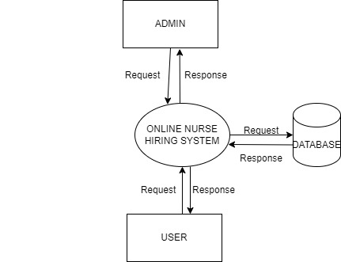
DATA FLOW DIAGRAM
LEVEL 0

Slide 22
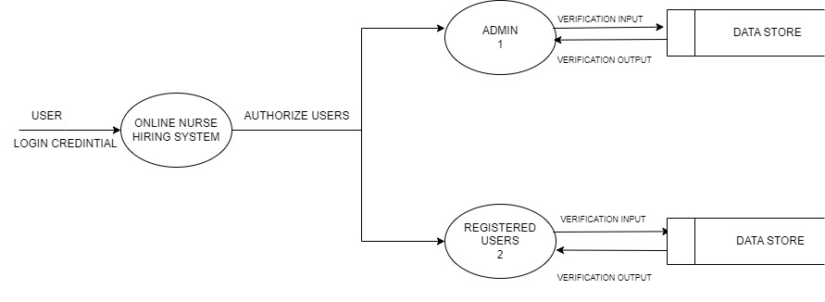
DATA FLOW DIAGRAM
LEVEL 1

Slide 23
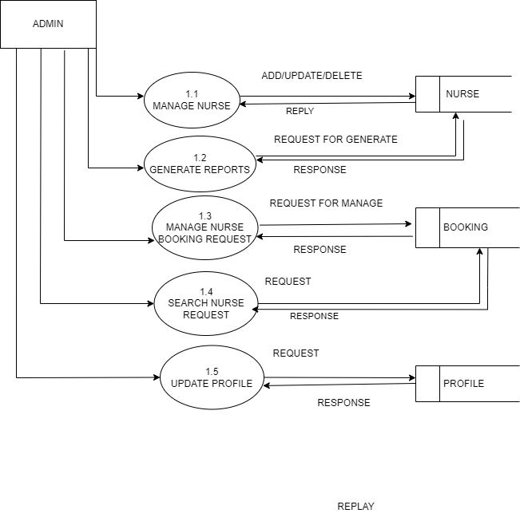
DATA FLOW DIAGRAM
Level 1.1

Slide 24
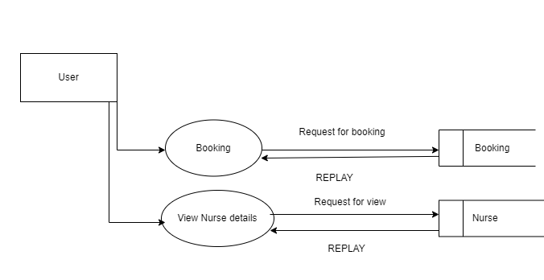
DATA FLOW DIAGRAM
%
Level 1.2

Slide 25
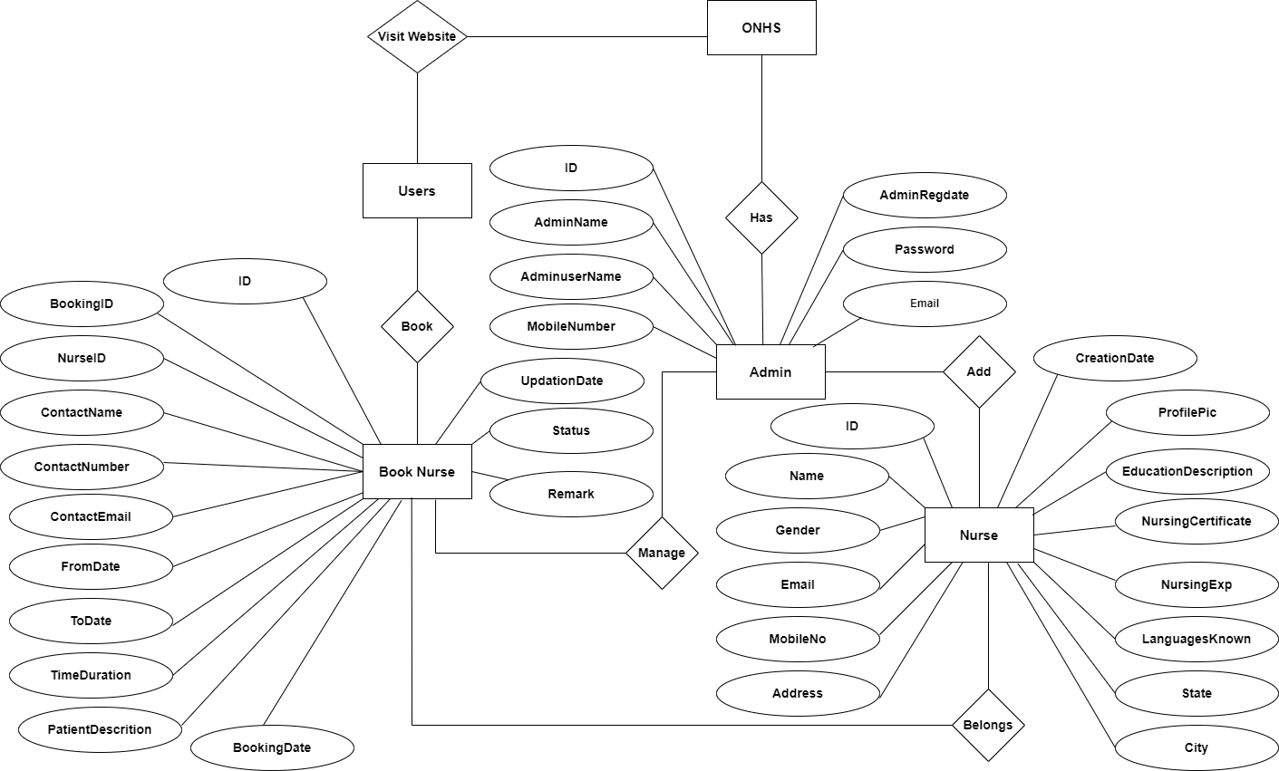
ER DIAGRAM

Slide 26
THANK YOU

